Slide 1
FluId Power Systems
BY Dr. OMARI MASHI KHALFAN
NATIONAL INSTITUTE OF TRANSPORT, MECHANICAL ENGINEERING DEPT.

Slide 2
HYDRAULIC ACCUMULATOR
A hydraulic accumulator is a device used in hydraulic systems to store energy. The storage is achieved by the ability of the device in keeping hydraulic fluid at high pressures as a result of compressibility of the gas the accumulator contains.
Construction and Operation:
Basically, accumulator is a cylinder which contains two types of fluids (gas and oil) separated by a bladder, diaphragm or piston depending on the type of accumulator.
The gas portion of the device is initially filled with a gas (generally nitrogen) at a certain charge pressure, P0 then oil is filled into the liquid portion up to a maximum operating pressure required P2. Then oil is discharged as pressurized gas expands until minimum operating pressure is reached P1.

Slide 3
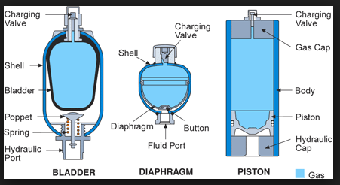
TYPES OF ACCUMULATORS

Slide 4
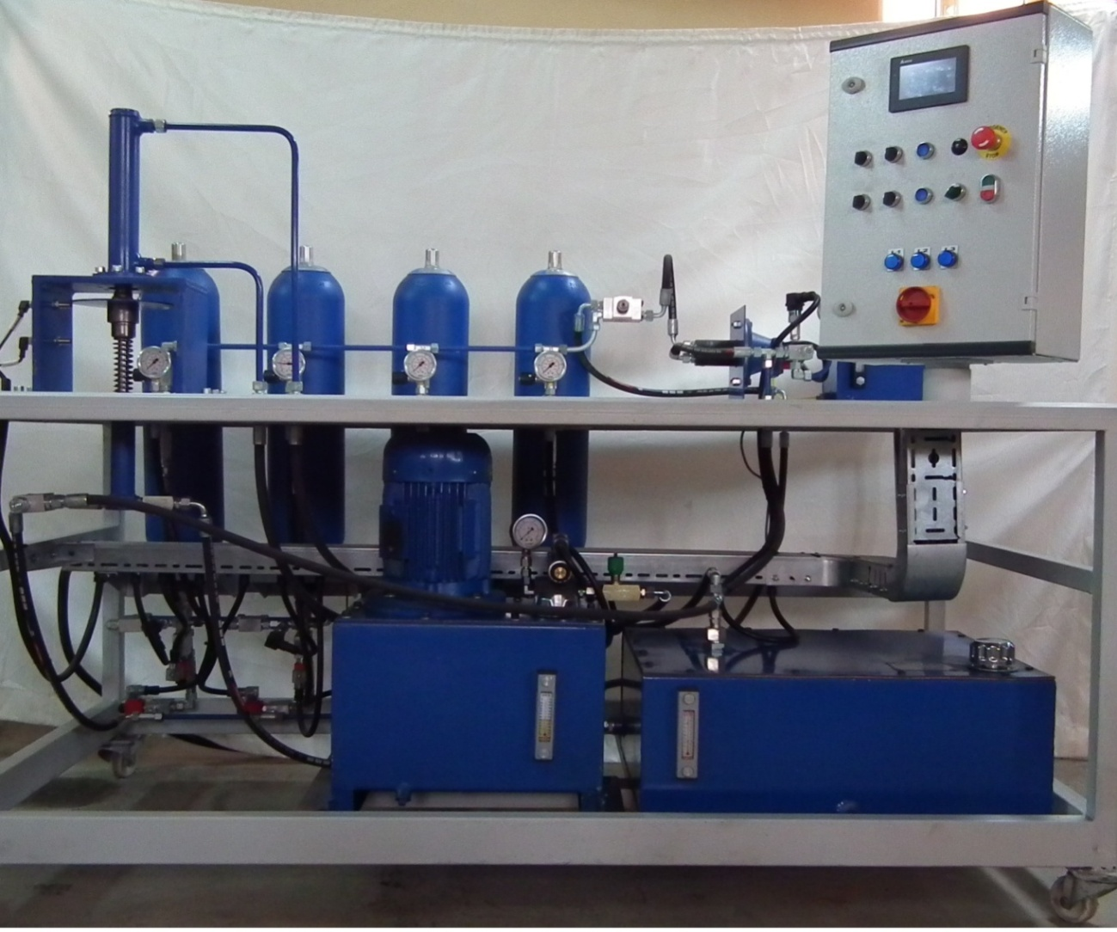
ACCUMULTORS

Slide 5
FUNCTIONS OF ACCUMULATORS
Accumulators have several functions in a hydraulic system. These are:
Energy storage . Fluid at high pressure can be stored in accumulator.
Used as a back up system in case of power failure (when no electricity the system can operate in emergency)
Provide additional volume of hydraulic oil into the system
Deadening pressure pulsation in hydraulic systems
Maintaining constant fluid flow when system demand is greater than pump supply

Slide 6
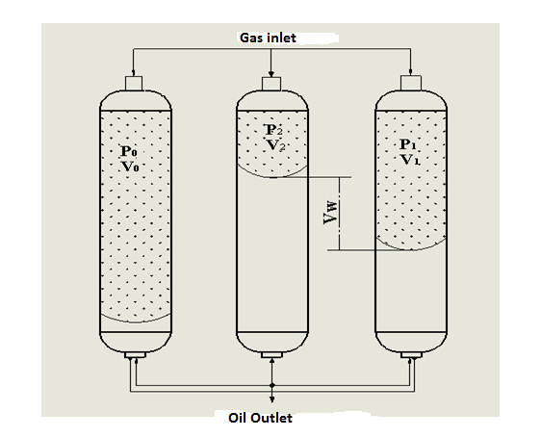
ACC-PRESSURE AND VOLUME RELATIONSHIP

Slide 7
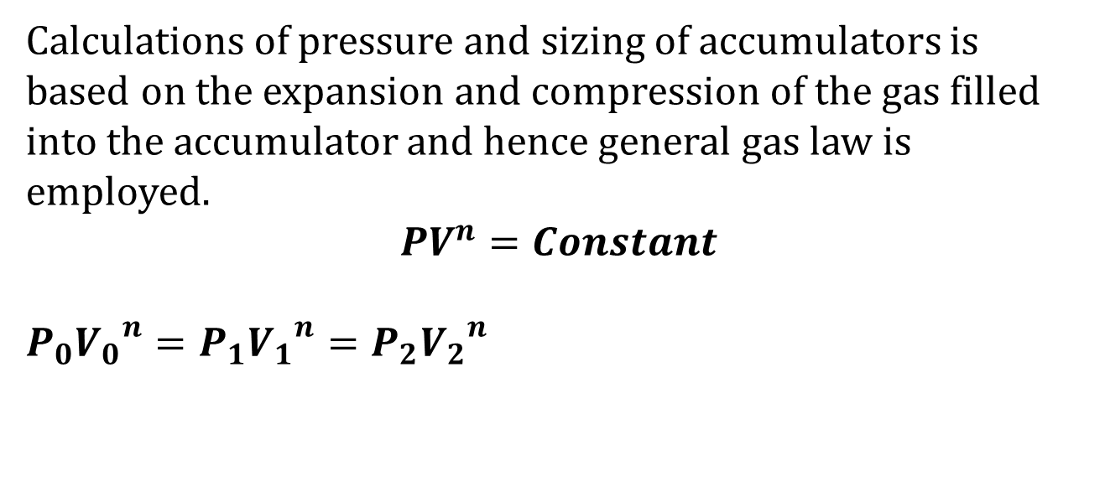
GENERAL GAS LAW
Calculations of pressure and sizing of accumulators is based on the expansion and compression of the gas filled into the accumulator and hence general gas law is employed.
$$PV^{n}=Constant$$
$$P_{0}{V_{0}}^{n}=P_{1}{V_{1}}^{n}=P_{2}{V_{2}}^{n}$$

Slide 8
Where, P0 : charge pressure, generally taken as
90% of the minimum operating pressure
P1 : Minimum operating pressure
P2 : Maximum operating pressure
V0 : Accumulator volume at charge pressure
V1: Gas volume at minimum operating pressure
V2: Gas volume at maximum operating pressure
n: is polytropic gas constant, for nitrogen n= 1.4

Slide 9
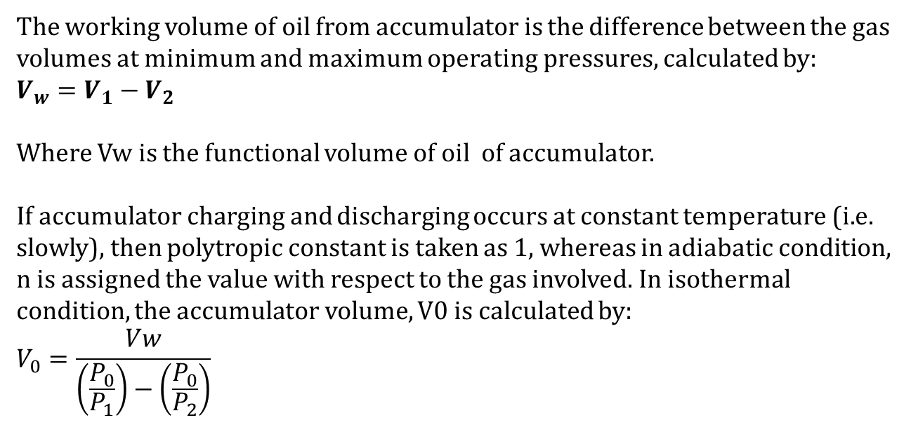
GENERAL GAS LAW
The working volume of oil from accumulator is the difference between the gas volumes at minimum and maximum operating pressures, calculated by:
$$V_{w}=V_{1}−V_{2}$$
Where Vw is the functional volume of oil of accumulator.
If accumulator charging and discharging occurs at constant temperature (i.e. slowly), then polytropic constant is taken as 1, whereas in adiabatic condition, n is assigned the value with respect to the gas involved. In isothermal condition, the accumulator volume, V0 is calculated by:
$$V_{0}=\frac{Vw}{\left(\frac{P_{0}}{P_{1}}\right)−\left(\frac{P_{0}}{P_{2}}\right)}$$

Slide 10
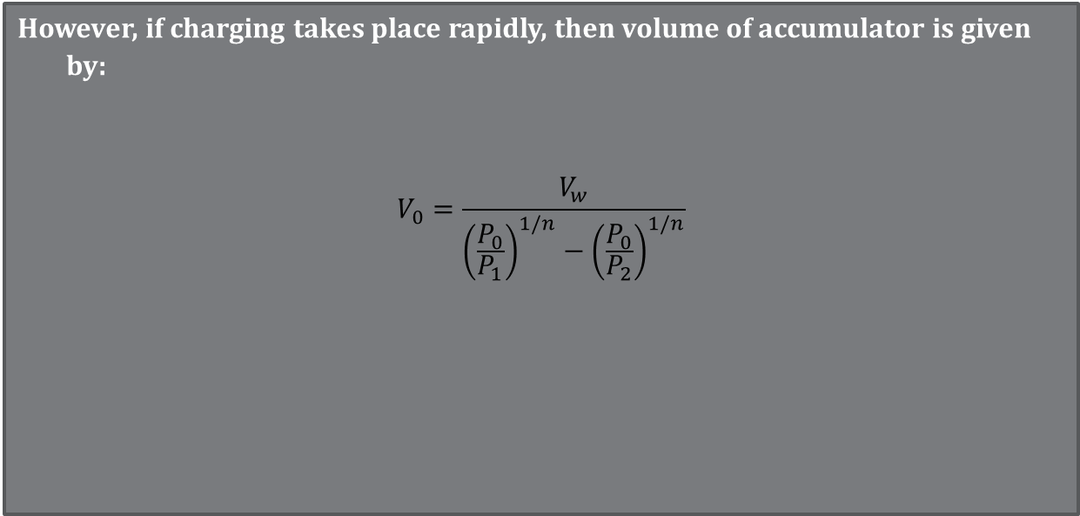
GENERAL GAS LAW
However, if charging takes place rapidly, then volume of accumulator is given by:
$$V_{0}=\frac{V_{w}}{{\left(\frac{P_{0}}{P_{1}}\right)}^{1/n}−{\left(\frac{P_{0}}{P_{2}}\right)}^{1/n}}$$

Slide 11
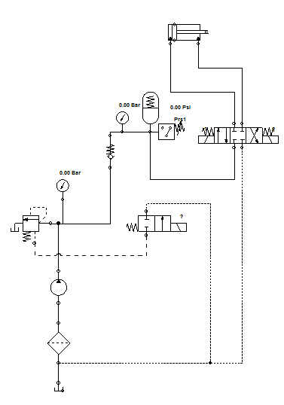
ACCUMULATOR CIRCUIT

Slide 12
example
An accumulator is to deliver 4 L of oil when ,operating between 207 bar and 110 bar in 0.8 s.
It is assumed here that the operating pressure is achieved by a slow charging process
such that the ideal isothermal process n = 1 may be assumed. If the gas used in the bladder has n=1.82. What is the size of the accumulator?

Slide 13
SolutIon:
Given :
P2= 207 bar,
P1=110 bar,
n= 1.82 therefore pre-charge pressure, P0= 90% P1
= 110(0.9)=99 bar.

Slide 14
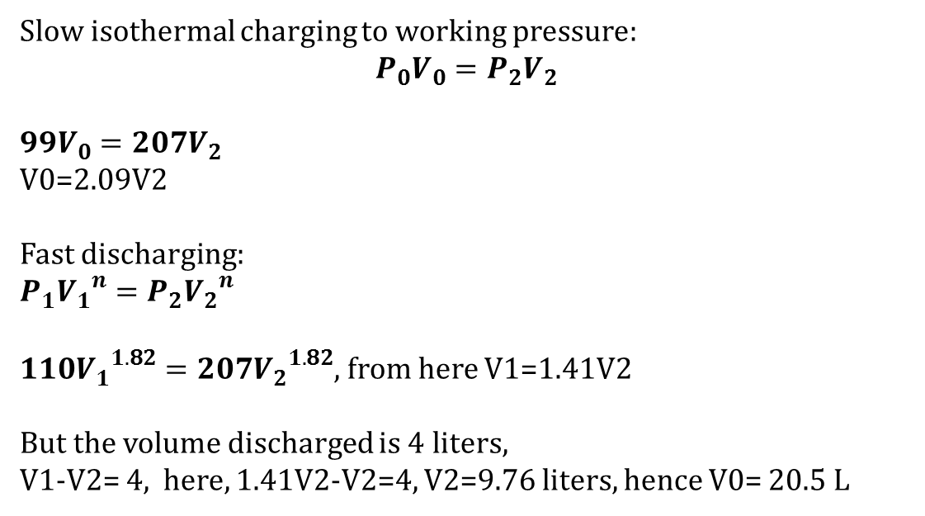
Slow isothermal charging to working pressure:
$$P_{0}V_{0}=P_{2}V_{2}$$
$$99V_{0}=207V_{2}$$
V0=2.09V2
Fast discharging:
$$P_{1}{V_{1}}^{n}=P_{2}{V_{2}}^{n}$$
$110{V_{1}}^{1.82}=207{V_{2}}^{1.82}$, from here V1=1.41V2
But the volume discharged is 4 liters,
V1-V2= 4, here, 1.41V2-V2=4, V2=9.76 liters, hence V0= 20.5 L

Slide 15
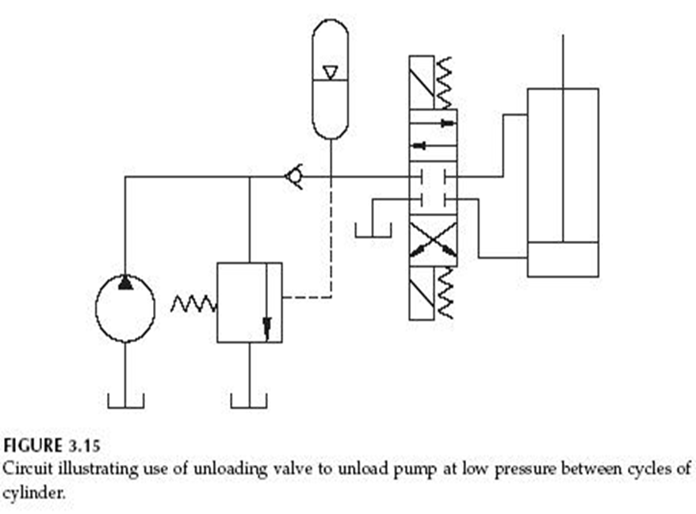
1.UnloadIng CIrcuIt wIth Accumulator
Accumulator
Unloading Valve

Slide 16
problems
The operating pressure of an 80 mm diameter cylinder is 160 bar. If the cylinder has a stroke of 100 mm and it is required that the stroke be completed in 5 seconds;
What should the pump flowrate be?
Calculate the power of the electric motor necessary to drive the pump for this application { Assume the efficiency is 0.85}
What should be the diameter of a cylinder operating at 160 bar if it has to exert a force of 126 kN ?
If the piston diameter becomes 80 mm; what will be the operating pressure?
If the pressure calculated above is used in retraction stroke how much force will be exerted if the cylinder has a rod diameter of 56 mm?

